Slide 1
StHC CoC (NY-511)
2026 Rank & Review Data Attachments

Slide 2
Purpose / Agenda
Purpose: support you in filling out Part 1 of the Rank & Review Renewal Tool.
Agenda:
  Review Scoring Methodology.
  Review Data Attachments and how to apply the information when filling out the Part 1 tool.
  Discuss next steps and deadlines.

Slide 3
Notes on the 2026 Rank & review Data attachments
All data based on Federal Fiscal Year 2025 APR reports (10/1/2024 – 9/30/2025), which will be provided to applicants in addition to this PowerPoint.
  This data was submitted to HUD for the annual Longitudinal Systems Analysis and cannot be changed.

Slide 4
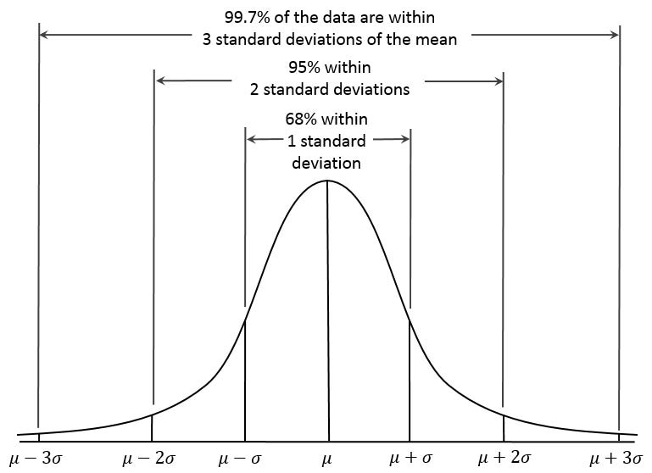
Scoring Methodology
Scoring ranges were determined using a basic bell-curve methodology.
If the project scored below μ-σ it fell into the 1st bucket. If the project scored above the μ-σ and below the μ, it fell in 2nd bucket. If the project scored above the μ and below μ-σ it fell in 3rd bucket. Any projects scoring over μ+σ will fall into the last bucket.

Slide 5

10. Length of Time between Project Start Date and Residential Move-in Date
Attachment #1
Scoring Rubric
≤ 14 days= 4 pts
> 14 days= 0 pts
Source: FY25 APR Q22C – ‘Average length of time to housing.
Notes:
Not Applicable to the question
Any projects with zero move-in
Site-based projects

Slide 6
11. Positive Outcomes
Attachment #2
Scoring Rubric
< 90% = 0 pts
90 – 91% = 7.5 pts
92 – 100% = 15 pts
Source: For PSH, RRH, and TH, programs, an outcome is positive if a client is a stayer or exited to a PH
destination that does not have a subsidy attached.
FY 25 APR Q23c. Exits to
Staying or living with family, permanent tenure
Staying or living with friends, permanent tenure
Owned by client, no ongoing housing subsidy
Rental by client, no ongoing housing subsidy
+ FY25 APR Q5 Number of Stayers /
FY25 APR Q5 Total Number of Persons Served
- FY 25 APR Q23c. Exits to Deceased, Foster Care, Hospital, and Long-Term care facility.
Not Applicable to the question and Avg/Stdev.p calculation
Any projects with no leavers and stayers
All Service Only projects

Slide 7
12. Positive Outcomes - Leavers
Attachment #3
Scoring Rubric
≥ 20% = 5 pts, < 20% = 0 pts
Source: 20% of your participants exited to a positive housing destination that does not have a
subsidy attached?
FY 25 APR Q23c. Exits to
Staying or living with family, permanent tenure
Staying or living with friends, permanent tenure
Owned by client, no ongoing housing subsidy
Rental by client, no ongoing housing subsidy
/FY25 APR Q5 Number of Leavers
- FY 25 APR Q23c. Exits to Deceased, Foster Care, Hospital, and Long-Term care facility.
Not Applicable to the question.
Any projects with no leavers minus excluded exits reasons
All Service Only projects

Slide 8
13. EXITS TO HOMELESSNESS
Attachment #4
Scoring Rubric
0-7% = 10 pts
8-19%= 5 pts
20+%= 0 pts
Source: FY25 APR, Q23c Exits to Place not meant for habitation + Exits to Emergency Shelter / APR Q5 Total Leavers
Not Applicable to the question and Avg/Stdev.p calculation
Any projects with no leavers
All Service Only projects
Notes:
Note: updated after tools went out to delete exits to hospitals (non-psychiatric), nursing/longterm care facility, and foster care from denominator to make neutral.

Slide 9
14. RETURN TO HOMELESSNESS
ATTACHMENT #5
Scoring Rubric
< 8% = 5 pts
≥ 8% = 0 pts
Source: FY25 SPM Measure 2b Number of Returns in 2 Years/ Total Number of Persons who exited to Permanent Housing Destination (2 Years Prior). Personal IDs were match to the project with earliest discharge date 2 years prior of SPM Reporting period and had an exit to Permanent Housing Destination.
Not Applicable to the question
No matching records based on personal ID and min discharge date to Permanent destination in FY25 SPM

Slide 10
15a. Increases in Client Income at Exit-PSH
Attachment #6a
Scoring Rubric
11%+ = 10 pts
6-10% = 5 pts
0-5% = 0 pts
Source: FFY25 APR 19a2 – Adults with Earned Income - Performance Measure: Percent of persons who accomplished this measure.
Not Applicable to the question and Avg/Stdev.p calculation
No Leavers APR Q5 – Adult Leavers = 0

Slide 11
15a. Increases in Client Income at Exit-TH/RRH
Attachment #6a
Scoring Rubric
13%= 10 pts
Source: FFY25 APR 19a2 – Adults with Earned Income - Performance Measure: Percent of persons who accomplished this measure.
Not Applicable to the question and Avg/Stdev.p calculation
No Leavers APR Q5 – Adult Leavers = 0

Slide 12
15B. Increases in Client Income at Annual Assessment-PSH
Attachment #6b
Scoring Rubric
33%+= 10 pts
24-32= 7.5pts
15-23%= 5 pts
0-14%= 0 pts
Source: FFY25 APR 19a1 – Adults with Earned Income - Performance Measure: Percent of persons who accomplished this measure.
Not Applicable to the question and Avg/Stdev.p calculation
FY25 APR Q5 - Number of Heads of Households and Adult Stayers in the project more than 365 days = 0

Slide 13
15B. Increases in Client Income at Annual Assessment-RRH & TH
Attachment #6b
Scoring Rubric
0%= 0 pts
Source: FFY25 APR 19a1 – Adults with Earned Income - Performance Measure: Percent of persons who accomplished this measure.
Not Applicable to the question and Avg/Stdev.p calculation
FY25 APR Q5 - Number of Heads of Households and Adult Stayers in the project more than 365 days = 0

Slide 14
18. Tracking Participant outcomes - % Exit to unknown destinations
Attachment #7
Scoring Rubric
< 10% = 5 pts
≥ 10% = 0 pts
Source: FY25 APR Q23c. OS Total – Exits to Deceased / APR Q5 Total Leavers
Not Applicable to the question
Any projects with no leavers – excl. Leavers (Exits to Deceased, Foster Care, Hospital, and Long-Term care facility)

Slide 15
Application Information
Errors in data should be reported to tgillespie@caresny.org by end of day June 24th, 2026. Note that data from APRs cannot be updated, but errors in calculations or in data submitted by those not entering into the HMIS will be assesses and corrected if possible.
Part 1 and 2 applications are due by July 2nd, 2026. Late submissions will lose points, per the CoC’s Written Process.
For questions regarding this process, please contact Taylor Gillespie at tgillespie@caresny.org

